Slide 1
IDA Financial Education Training
January 17, 2020

Slide 2
Training Objectives
Participants will:
Learn, share, and practice strategies to be more effective facilitators of adult financial education
Understand the role of economic literacy in financial education
Participate in train-the-trainer sessions for three topics from the IDA Financial Education Standards:
A) Consumer Rights & Identity Theft
B) Taxes
C) Investments

Slide 3
Agenda Overview
Morning
9:10am: Ice-Breaker
9:40am: Role of Economic Literacy in FE
10:40am: Break
10:55am: General FE Strategies
11:10am: Adult Learning Styles Group Activity
Noon: Lunch
Afternoon
12:45pm: Overview of FE Standards
1:00pm: Session A: Consumer Rights & Identity Theft
1:50pm: Session B: Taxes
2:40pm: Break
2:50pm: Session C: Investments
3:40pm: Closing Activity

Slide 4
Group Agreements
Stay engaged
Listen to Understand
Expect and Accept Non Closure
Have Fun
Notes:
Agreements are a more than a vehicle to keep conversations safe and focused. When used to their potential, agreements are an actual tool. Agreements are a tool that support both individuals and group in creating a brave space share information inclusively. We look forward to all participants to honor the following agreements.

Slide 5
Behavioral Economics is the study of psychology as it relates to the economic decision-making processes

Slide 8
Anchoring
Compromise Effect
Earmarking
Defaults: Opt in/Opt Out
Decision Points
Framing: Pennies-A-Day
Goal Visibility
Temptation Bundling

Slide 9
Introductions: Name, Pronoun & Organization
Do you relate personally with this Behavioral Economic principle?
What financial education topic could this behavioral economic principle be applied to?
Write down some ideas for how this principle could inform your financial education

Slide 10
Behavioral Economics Reading List

Slide 11
Economic Literacy
Julie Wang

Slide 12
Economic literacy is a measure of whether people understand the forces that significantly affect the quality of their lives.
Notes:
The traditional approach to Financial Education
Often 1 day long session or a series of short sessions
Covers a range of topics from budgeting to investing
Primary objective is to get learners key information so they can institute changes at their own pace
The guiding principle is “When we know better, we do better”
The traditional model assumes people just need financial education to be able to thrive financially. It’s been embraced by financial institutions, schools, and government agencies. No doubt, these skills and knowledge are important- they are only a piece of the puzzle.
The traditional approach to financial education omits economic literacy. We’ve divorced the understanding and evaluation of our economic, social and political history from financial education and it’s hurting our participants and our democracy.
Let’s define wealth- Who can give me the definition of wealth?

Slide 13
Wealth in the United States
Everything you own
(property, cash, stock, personal valuables, businesses)
- Everything you owe
(loans, mortgages, debt)
= Wealth AKA Net Worth
Wealth ≠ Income

Slide 14
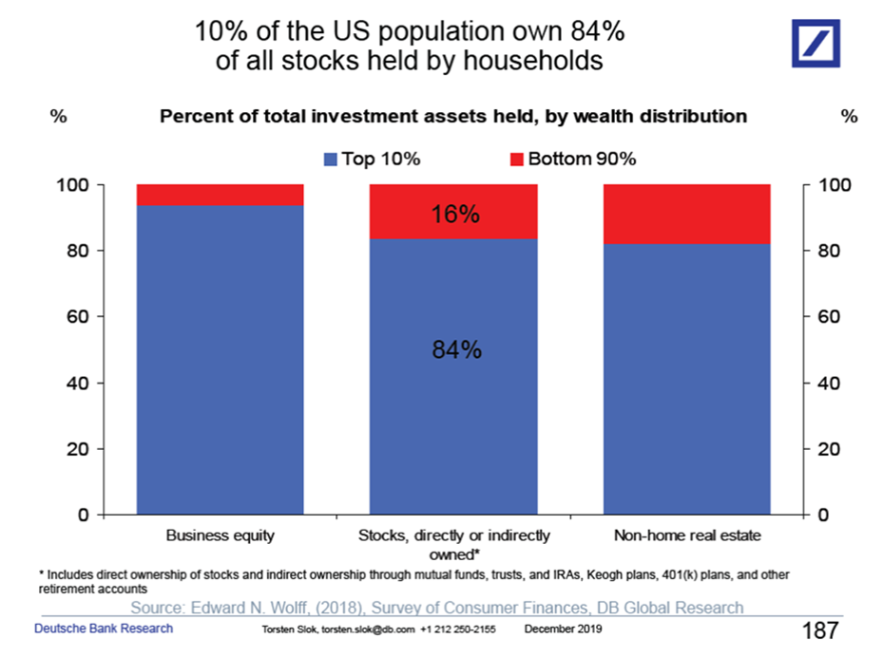
Notes:
The Census formally defines income as received on a regular basis (exclusive of certain money receipts such as capital gains) By this official measure, the wealthiest families may have low income, but the value of their assets earns enough money to support their lifestyle. Dividends from trusts or gains in the stock market do not fall under the definition of income but are the primary money flows for the wealthy. Retired people also have little income but usually have a higher net worth because of money saved over time.
2016- the distribution of U.S. stock market ownership (direct and indirect through mutual funds) in the U.S., which is highly concentrated among the wealthiest households
when politicians reference the stock market as a measure of economic success, that success is not relevant to nearly half of Americans. Most Americans Don’t Have a Real Stake in the Stock Market.This doesn’t stop politician, CEO’s and the media from telegraphing the message that the rising tide lifts all boats.

Slide 15
$94.7 Trillion / 124 million households=
$760,000
Per Household *2016

Slide 16
10 Chair Simulation
Notes:
15 minutes

Slide 17
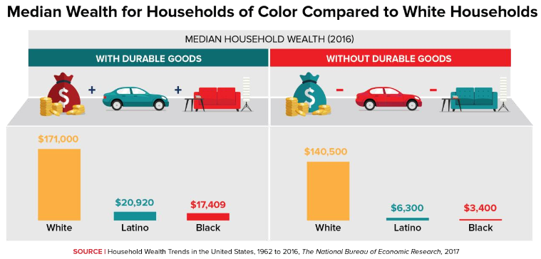
Image from “Prosperity Now: Promise Accounts: Matched Savings to Help Families Get Ahead”

Slide 18
Barriers to Building Wealth
Shifts in the employment market
Stagnant wages and a minimum wage that has not kept up with the costs of living, decline of unions and labor rights, increases in contract labor, global treaties that benefit corporations etc.
Federal and state policy
An upside-down tax code that perpetuates the racial wealth divide, elimination of federal programs, savings penalties.
High levels of debt and the high cost of credit
Predatory lending targeted to communities of color, increasing and racially disproportionate troublesome debt.
Financial services system
Historic and present-day underservice, predation, and unresponsive products and services for communities of color has led to distrust in traditional financial institutions.
Notes:
So what are these designed barriers that make it challenging for lower income folks and people of color to achieve financial stability? These include:
Shifts in the employment market
Including stagnant wages and a minimum wage that has not kept up with the costs of living. Erosion of the real value of the minimum wage ($7.25- $11.62) A shift from higher paid manufacturing jobs to lower paid service jobs (globalization) Global treaties benefit corporations
As a result of discrimination in the labor market, education systems, and others, these shifts disproportionately impact people of color.
Federal and state policy
Including an upside-down tax code that primarily support the savings and reduction of the tax burdens of the wealthy but do little to encourage savings of low-income or low-wealth families. Given the existing racial wealth divide, this upside down policy disproportionately impacts people of color and furthers the divide. Moreover, the elimination of federal programs, such as AFI, the inclusion of savings penalties in public benefits programs that prevent families from saving too much less they lose their benefits, are also imposing barriers.
High levels of debt, particularly troublesome debt, and the high costs of credit for many communities is also a major barrier. For example- despite holding less debt than white Americans, African Americans have more difficulty paying off debt- this is often due to higher costs of debt for African Americans as a result of both discrimination in lending and higher interest rates, creating a vicious cycle.
And the financial services system
The historic—and ongoing—underservice, predation, and unresponsive products and services in communities of color have led to, among other things, a distinct lack of trust between communities of color and financial services.
These challenges disproportionately impact families of color, make managing day-to-day needs increasingly difficult, let alone building savings and wealth over a lifetime.
We acknowledge that to truly and fully address these challenges, we need a dramatic shift in policy and institutional practices in this country.
Federal tax and asset building policies that favor the wealthy and corporations
Erosion of the real value of the minimum wage ($7.25- $11.62)
Disparity between average CEO to worker pay (278 to 1)
Media focus individual deficiencies
$$$ in Politics

Slide 19
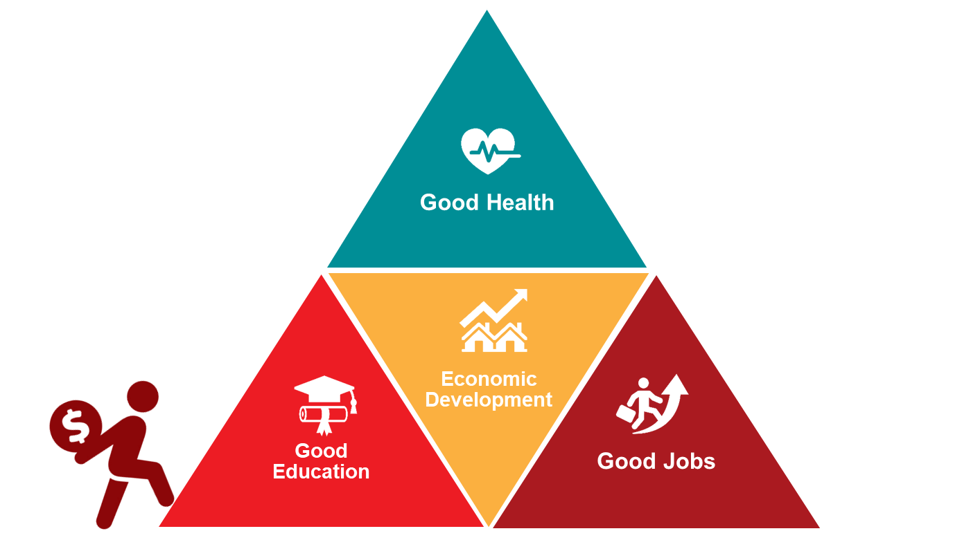
A SYSTEMS APPROACH
System: “A system is an interconnected set of elements that is coherently organized in a way that accomplishes something.” – Donella Meadows
E.g. engine, household, economy
Systems Thinking: A conceptual way of seeing the world and exploring the interrelation between parts and wholes, so we can focus on adjusting systems in order to help improve outcomes.
Source: Applied Research Center
Notes:
Remember that we said financial insecurity impacts all areas of a person’s life? Consider how this financial stress can negatively impact a client’s ability to access, engage, and succeed with your existing services.
Housing agencies struggle to keep clients in their homes when they don’t have good financial management skills;
Workforce agencies struggle to find jobs for clients with low credit scores
Without tuition assistance such as an IDA might provide, hard to get training for a better job
Clients coming back for repeat emergency assistance such as utility subsidies or food pantry help may need to have some of the root causes addressed through financial counseling
One way to think about structural barriers and how to address them is through a systems approach.
Systems are generally considered a collection of parts that operate as a whole; and those parts are all directly or indirectly connected to each other and the outcomes of those systems. Systems thinking is a conceptual way of seeing the world and exploring the interrelation between parts and wholes, so we can focus on adjusting systems in order to help improve outcomes.

Slide 20
Source: United for a Fair Economy
Notes:
As we explore the topic of the Racial Wealth Inequality today, I would like to revisit for some and introduce to others this very detailed infographic – Government Boosts and Blocks to Build Wealth created by United for a Fair Economy. It is a mis-step for us to move through conversations of financial capability and fail to acknowledge the historical context of our government's intentional efforts to create a concept of wealth for white people while systematically creating policies to block wealth for people of color.
Aside from what most understand –
slavery, free labor of enslaved Africans to accumulate wealth for whites
While this image is hard to read on the screen, I encourage you to review the Boosts and Blocks to Building Wealth.

Slide 21
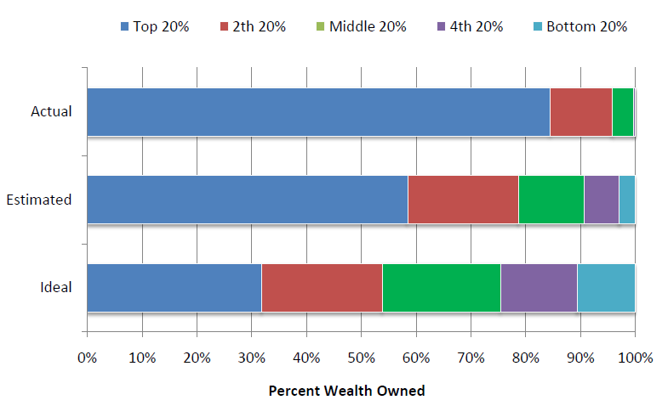
Wealth Distribution in the United States
Ariely, Dan and Norton, Michael. (2010) “Building a Better America – One Wealth Quintile at a Time”
Perspectives on Psychological Science.
Notes:
(2002) When participants of the study were asked how much do you think of the wealth is owned by the top 20 percent, the next 20, the next 20, they found that people dramatically underestimated how much wealth the wealthy have, but also dramatically overestimated how much money the poor have.
The top bar is the actual distribution of wealth in the US. As you can see, the share held by the fourth and fifth quintiles are so small, they don't appear on the chart.
These results demonstrate that Americans appear to drastically underestimate the levels of wealth inequality, suggesting they may simply be unaware of the severity of the gap. Second, just as people have erroneous beliefs about the actual level of wealth inequality, they may also hold overly optimistic beliefs about opportunities for social mobility in the United States. Could this be fueled by economic illiteracy?

Slide 22
The Underlying Mainstream Belief and Assumption:
Hard work and good character will yield success.
Notes:
Assumes the playing field is neutral. Without a wider context, the message becomes “You aren’t succeeding because you, individually, are not doing it right”. It’s disempowering, unmotivating and perpetuates the status quo.

Slide 23
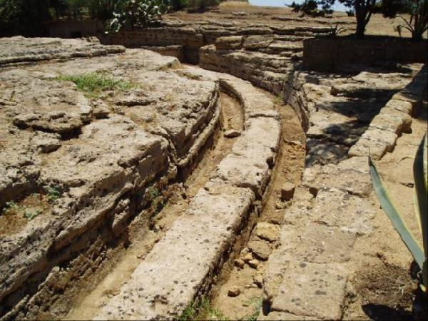
Ruts in a Well Traveled Path
Notes:
Our social, political and economic history make a difference in how we see ourselves. How we see ourselves affects our self-efficacy. There is a tape in our head that is telling us that whatever we’re doing, it’s not good enough because those people on TV have made it and I haven’t. When you are able to recognize the institutional obstacles blocking your success, you start to overwrite that tape. Overwriting this tape is how we form new neural pathways. We want them to make individual changes to their financial behaviours and not be weighed down by self-defeating thoughts propped up by poor public policies of the past. We want them to be activated to affect change in the public policy arena. Providing context cuts new pathways in our brain. Building power to changes the rules

Slide 24
Including Economic Literacy in FE
Financial Education Concept | Formal/Informal Policy Linked to FE Concept | Curricular Ideas
Your ability to stick to a budget.
Your ability to build savings and acquire assets.
Accessing credit/loans
Taxation
Managing debt
Retirement

Slide 25
Break

Slide 26
General Financial Education Strategies
Demus Martinez

Slide 27
Adult Learning Styles
Sami Stephens

Slide 28
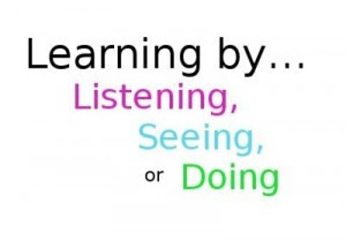
Learning Styles
In General, we retain:
10% of what we see
30-40% of what we see and hear
90% of what we see, hear and do
Most people learn using all learning styles, but one is usually dominant.
It is important to teach to all learning styles so that everyone can retain as much knowledge as possible.

Slide 29
Doer
Learn through applying the knowledge
Hands on
Clear and concise instruction
Activity Examples:
Role Playing
Simulations
Practice Demonstrations

Slide 30
Feeler
How will this help others? / How will this affect others?
Relate to personal experience
Value trust, respect and compassion and people oriented
Sense emotions and work best in a harmonious classroom
Group/partner work
Activities:
Role Play
Presentations, teaching others
Discussions

Slide 31
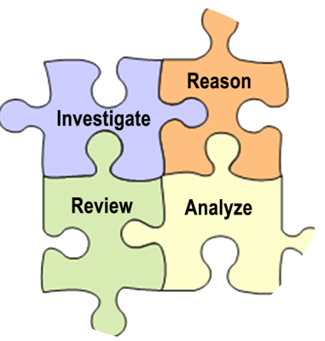
Thinker
Focus on Logic
Like analyzing, examining and evaluating
Enjoys compare and contrast activities
Likes independent work
Activities:
Memorization activities
Debating
Analyzing Games

Slide 32
Observer
Likes to watch and listen
Observes situations before participating
Relies on personal experiences and prior knowledge
Activities:
Visual: Charts and graphics
Question and answer (so they repeat information)
Lecture style

Slide 33
The Activity
Please break into groups based on your most
dominant learning style.
Discuss:
For your learning style, what would a great
session look like for this topic?
What would a bad session look like?
Create:
Each group will have a financial standard topic.
Create an activity based on that standard that could be used for your learning style for both a great session and bad session.
Come back together to share with the room.

Slide 34
Report-out

Slide 35
Lunch
Back at 12:45pm

Slide 37
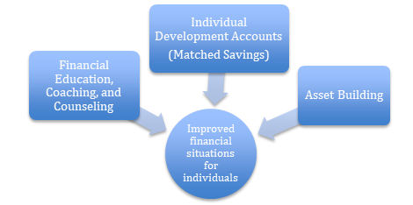
OR IDA Financial Education Standards

Slide 38
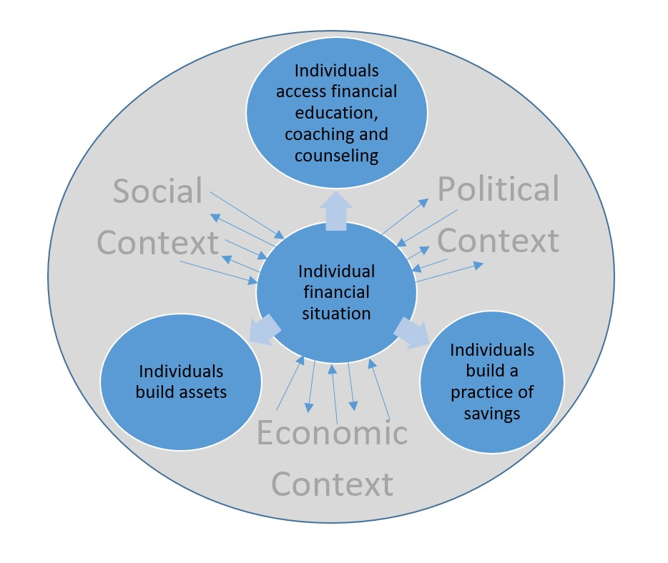

Slide 39
OR IDA Financial Education Standards
Clear guidance on the baseline financial education that all IDA savers should have access to

Slide 40
Baseline Topics for IDA Financial Education
Topic 3: Expenses
Topic 4: Budgeting
Topic 8: Building Savings
Topic 11: How Credit Works
Topic 15: Loan Products
Topic 16: Debt Repayment
Topic 19: Consumer Rights
Topic 21: Assets, Liabilities, & Net Worth
Topic 24: Financial Products
Topic 26: Protecting Assets
Topic 27: Understanding Taxes
Topic 31: Investing to Achieve Goals

Slide 41
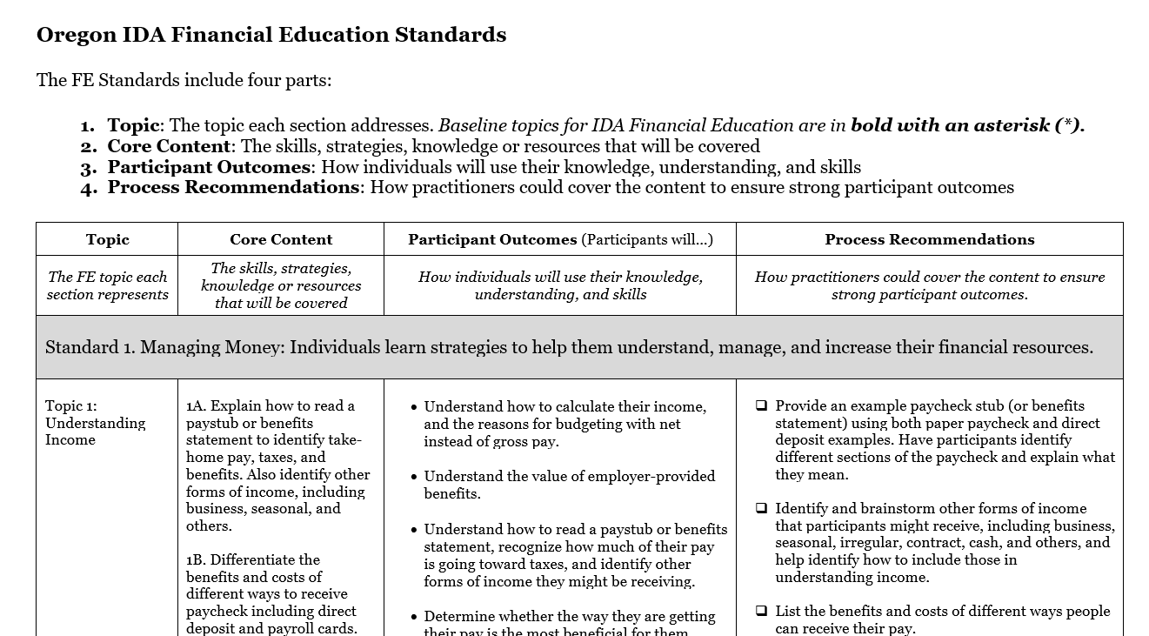

Slide 45
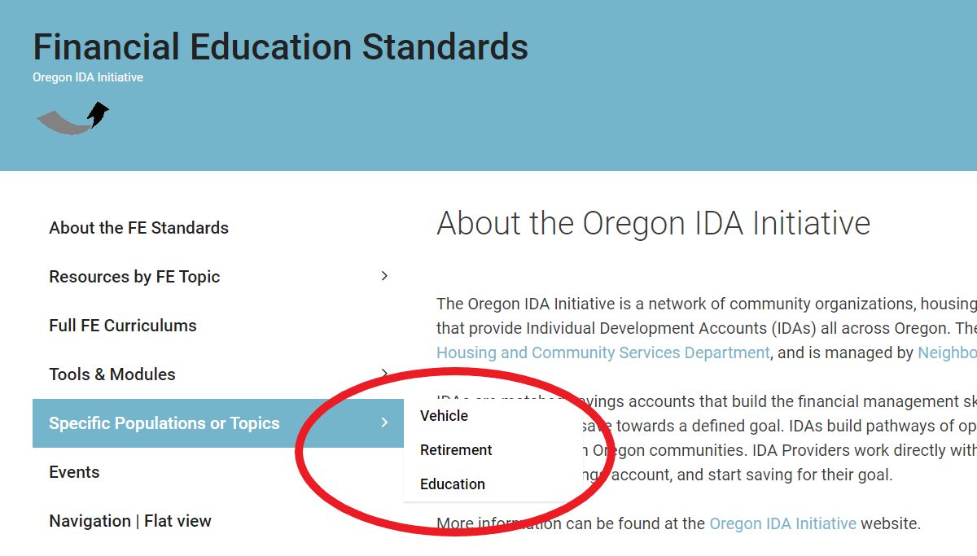

Slide 47
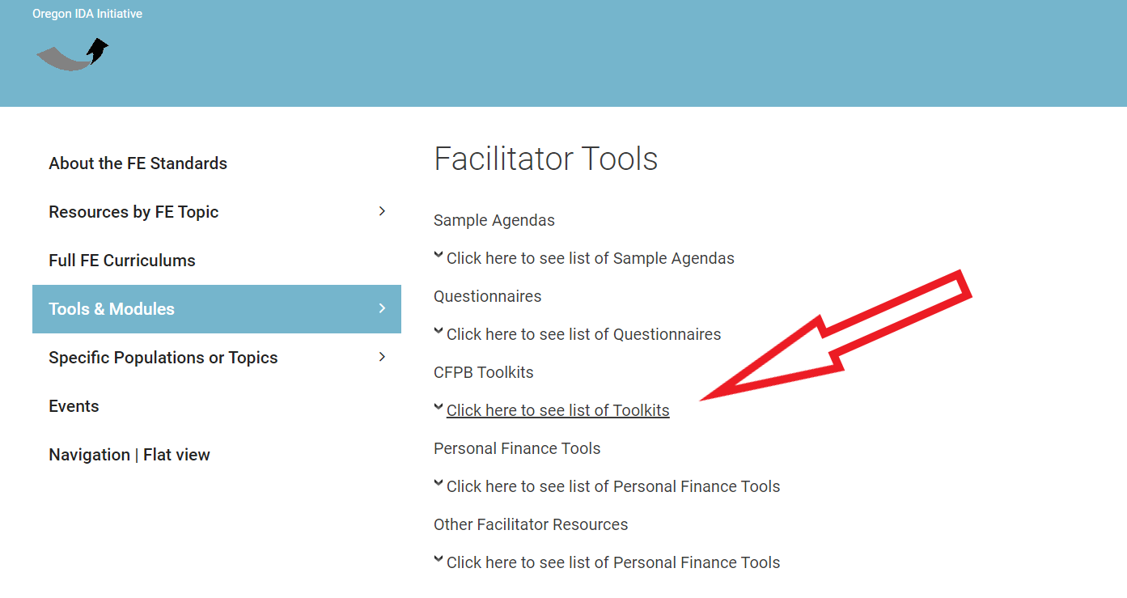

Slide 48
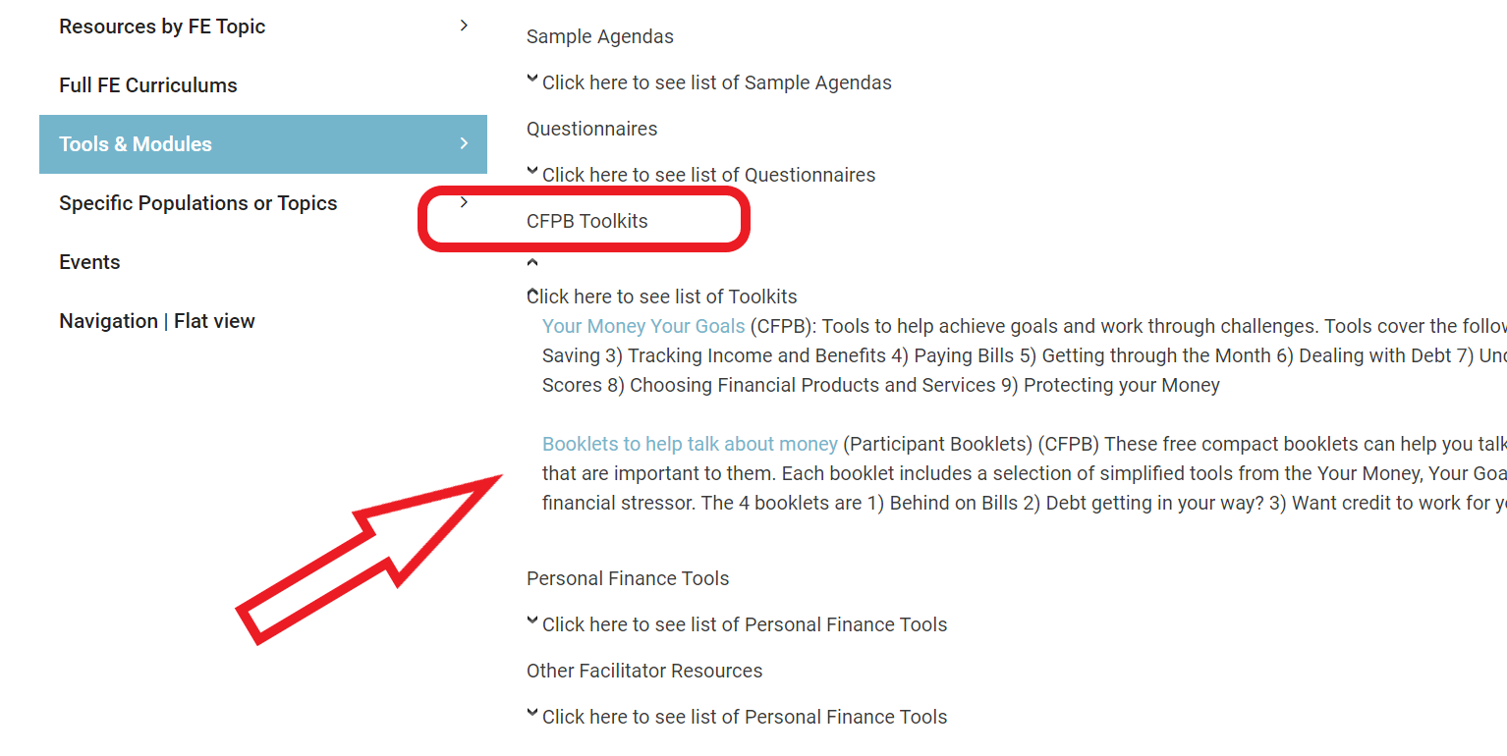

Slide 49
www.FinancialEducationStandards.org

Slide 50
Session A: Consumer Rights & Identity Theft
Frank Boothby

Slide 51
Consumer Rights & ID Theft: Overview
Current approaches to these topics at various FOs & partners?
What works? What doesn’t? How do we know?
Needs assessments: clients and staff
Facilitating: awareness of and respect for learning styles/preferences

Slide 52
Consumer Rights & ID Theft: Best Practices
Content / Information
Explain rights and responsibilities
Provide context as needed
Equity lens: how are barriers to access relevant to these topics?
Provide handouts, checklists, etc.
Cite reliable sources; provide links for additional reading
How to find & evaluate reliable information
Keep current; update and revise to provide the most recent information

Slide 53
Consumer Rights & ID Theft: Best Practices
Teaching / Facilitating / Education
Clients are the experts on their lived experiences
Language should avoid assigning blame or stoking fears
Language shouldn’t assume common knowledge
Informing / supporting / coaching -- not advising
Address why the material matters
Encourage development of strong self-advocacy skills
Recognize and respect different learning styles/preferences; provide options for all learners

Slide 54
Consumer Rights & ID Theft - Core Content:
History & Equity
Who is most affected by abuse, theft, and fraud? Why?
Elderly - tax & medical ID theft; long-term care staff fraud
Children - unlikely to have active monitoring on accounts; SSN not yet registered with any reporting agencies
College students - tend to share personal info widely; may not keep IDs secure or shred docs
Active military – SSN as identifier; unable to actively monitor, may not use fraud alert; family and friend theft
Low-income households – financial injury & emotional stress compounded by consequences for benefits, subsidized housing, medical care, etc.
Immigrants & refugees - scams specifically target these populations
DV survivors - abusers had access to confidential information

Slide 55
Consumer Rights & ID Theft - Core Content:
History & Equity
Emphasize:
Current relevance of systemic barriers
Navigating unfair systems
Why consumer rights legislation matters
Importance of being informed consumers
Self-advocacy skills / overcoming fear

Slide 56
Consumer Rights & ID Theft - Core Content:
History & Equity
Before consumer rights legislation:
Sellers only liable for gross negligence
Limited oversight -- safety, authenticity, etc.
Limited legal recourse

Slide 57
Consumer Rights & ID Theft: Core Content
Consumer Rights
Safety
Information
Choice
Be heard
Protection of ID
Consumer Responsibilities
Research products/services prior to purchase
Check providers’ qualifications
Read & follow product instructions
Understand your rights
Protect your information

Slide 58
Consumer Rights & ID Theft: Core Content
Consumer Protection Legislation
Consumer Credit Protection Act (CCPA)
Truth in Lending Act (TILA)
Fair Credit Reporting Act (FCRA)
Fair Debt Collection Protection Act (FDCPA)
Truth in Savings Act (TISA)
Fair Packaging and Labeling Act (FPLA)
See handout.

Slide 59
Recent Violations
2014 – ATT and false advertising
2017 – Lenovo installing bloatware
2012 – DISH Network telemarketing
2016 – DeVry's deceptive job placements
2017 – VW high gas mileage
2017/2018 – Uber’s promise of income and data breach
2017 – Equifax’s breach of data
2019 - ARCO/BP failure to disclose fees
See handout.

Slide 60
Consumer Rights & ID Theft: Core Content
ID Theft Prevention
Keep your debit, credit, and benefit cards in a wallet. Cancel immediately if lost.
Do not share any of your PINs with others. Cover the ATM when you type your PIN.
DO NOT share your Social Security number with others. Leave SSN card at home & memorize.
Shred receipts, credit card offers and anything with with personal information before discarding.
Do not give financial or personal info through email.
Do not reply to, or click on any links in, email about finances.
Do not share your online/mobile banking passwords with others.
Keep your phone locked when not in use.
Sign the back of all debit and credit cards. Write “check ID” next to signature for extra security.
Request a credit report once every year. Check for unfamiliar accounts.
Beware of special crimes (“scams”) targeting immigrants and refugees.
Do not give information to anyone by phone or email.
USCIS/ICE/IRS/police do not ask for money or info by phone.

Slide 61
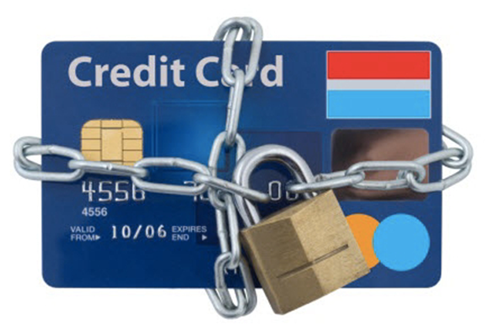
Consumer Rights & ID Theft: Core Content
ID Theft Resolution
1. Call your financial institution to report fraud as soon as you discover it. DO NOT WAIT.
2. Set up a fraud alert or credit freeze. 3. Complete any required forms for your financial institution.
4. File a report with police. Call the non-emergency police phone number or go to the police station.
Keep copies of all fraud paperwork for your records.
In most cases, if you report theft immediately and do what is required by the bank, money stolen by identity theft will be returned.

Slide 62
WHADAYATHINK?
What happened? How could it be avoided?
Kaden received an email asking him to confirm his credit card information. He clicked on the link and filled in the requested information: name, social security number, credit card number, security code, and expiration date. When he got his next credit card statement, he discovered many charges he had not made.

Slide 63
WHADAYATHINK?
What happened? How could it be avoided?
Alexis has not received a bill from her credit card company in the mail for three months. She has been using the card, but has not made any payments since she has not received a statement. She called the company and discovered there are many more charges to her account and her statement has been mailed out to her “new” address.

Slide 64
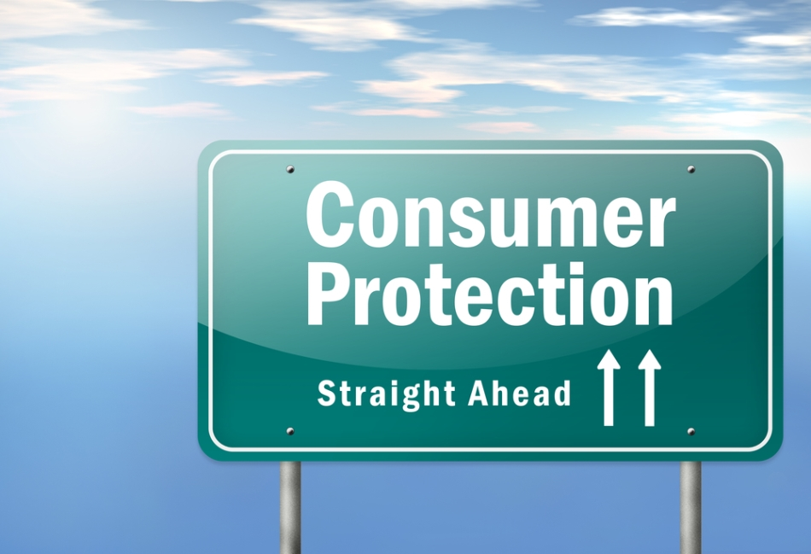
Consumer Rights & ID Theft: Discussions / Activities
Consumer Rights - Prompt:
Have you been treated unfairly? What happened?
Are you concerned you will be treated unfairly in the future?
Which consumer protection act applies to your situation (consider past, present, or future)?
Which agencies would you contact for assistance?

Slide 65
Consumer Rights & ID Theft: Discussions / Activities
ID Theft - Prompt:
Who has access to your personal / financial information?
Is your information safe?
How is it secured?
How do you know?
What are some things you can do today to protect yourself from ID theft?

Slide 66
Consumer Rights & ID Theft: Discussions / Activities
Self-Advocacy - Prompt:
Do you feel comfortable defending your rights? Why / why not?
Are you comfortable dealing with financial institutions and/or government agencies?
How have you overcome your fears in dealing with institutions?

Slide 67
Consumer Rights & ID Theft: Discussions / Activities - Learning Styles
DOER: Likes to be actively involved in the learning process, wants to know how s/he will apply learning in the real world, likes information presented clearly and concisely.
FEELER: People-oriented, expressive, focuses on feelings and emotions, thrives in open, unstructured learning environment.
THINKER: Relies on logic and reason, likes to share ideas and concepts, analyzes and evaluates, enjoys independent work.
OBSERVER: Likes to watch and listen, tends to be reserved, will take his or her time before participating, thrives on learning through discovery.
Let learners choose how to participate according to their learning styles/preferences:
Draw / map / diagram
Write
Speak
Work alone or with others
Think now, write at home
etc.

Slide 68
Consumer Rights & ID Theft: Additional Resources on www.financialeducationstandards.org
Consumer Rights
Oregon DCBS
OR State Bar: Consumer Rights & Remedies
FTC: Credit & Consumer Rights
CFPB: FCRA
CFPB: TILA
CFPB: FDCPA
CFPB: TISA
FTC: FPLA
FDIC: CCPA
OR Mortgage Loan Servicer Practices Act (2017 SB 98)
Fraud & Theft
CFPB: Fraud & Scams
OR DOJ: Report Scams & Fraud
NCLC: ID Theft Prevention
NEFE: ID Theft Checklist
FTC: Know Your Rights
FTC: ID Theft Recovery Plan & video
FTC: Credit Freeze FAQs
SmartAsset: Should You Sign Credit Cards?
Experian: 20 Types of ID Theft
Facilitating / Teaching / FE
Facilitating Effective Group Discussions
Pedagogies & Strategies
Adult Learning Theories
What Is Differentiated Instruction?
Bloom’s Taxonomy
IASP: Empowerment Economics
Self-Advocacy Characteristics

Slide 69
Taxes
Rachell Hall

Slide 70
Financial Education Training: Taxes

Slide 71
A Little About Us
IC$ exists to help people build their financial skills so that they can achieve a financially stable future. We offer:
Financial education workshops like this one and more
One on one coaching
Credit Building Opportunities
Matched savings accounts to save for post-secondary education, retirement, adaptive technology
If you have questions about these programs, give us a call at 503-687-3336 or contact@innovativechanges.org and our staff would be happy to talk with you about them!
Notes:
IC$ is a non-profit and we work in partnership with about 40 other social service organizations and affordable housing agencies throughout the Portland Metro area. We are located in the Lloyd Center Mall
Financial Education. This is open to anyone and we have several ways that you can participate in our financial education.
We do one on one coaching- so we are happy to sit down with you and work on whatever you want. We can help you make a budget, pull and review your credit report, set goals and stick to them, etc. All you need to do is contact us to make an appointment. This is a free service for anyone who needs it. The most common coaching topics are credit repair and budgeting, and each person decides what they will work on.
We have a 4-part workshop series to help you build your basic financial management skills. we offer this series every other month at our office in the Lloyd Center. (hand out fliers). These classes cover 4 main topics and are applicable to people in any situation- hand out flier with schedule and class topics.
In addition, we do seminars, like this one, on specific topics of interest to the community. Popular ones include: Teaching Your Kids about Money, Tackling Student Loan Debt and Dealing with Debt collectors. (see back of flier for upcoming seminars). We often teach these at libraries around town.
We also have a loan program. We were founded as an alternative to payday lenders and a way of providing access to credit building opportunities since credit can be important for achieving goals. If you have questions about our loans, you can email or call us.
We also have an asset building matched savings account program. it is called an IDA or Individual Development Account that helps you save to go to any kind of schooling beyond high school. For every dollar that you save you get that dollar matched with $3 more! It’s a great deal. this program qualified individuals commit to saving a set amount of money every month, which is at least $25 per month, enroll in IC$ financial education workshops and education planning sessions and receive a three to one match that can be used for tuition or school/certificate fees and expenses. This program is open for anyone to apply! Pass out IDA flier.

Slide 72
Disclaimer
This workshop was created with the help and advice of CASH Oregon. Innovative Changes does employ trained tax preparers. We recommend consulting a certified IRS trained professional.
Innovative Changes is not responsible for the advice or actions of each individual. We provide a broad overview of taxes and individuals need to be aware that there can still be a lot of “yes but”, “if than”, and “only in the event of” circumstances that exist in regards to ones taxes.
Notes:
Keep in mind there are State and Federal requirements at play.

Slide 73
Seminar Outline
Overview of taxes
Understand the reason for filing taxes and how taxes are used
Explain purpose of W-4
Describe the difference between W-2 and 1099
Explain common taxes federal, state, self employment
What are ways to grow your tax refund

Slide 74
Before we begin….
Please tell us:
What’s the first thing that comes to mind when you hear the word TAXES?

Slide 75
How Do Taxes Work and Why We Care?
Federal Taxes are used to fund schools, roads, public works, social programs, community development, law enforcement, defense and security
In 2017
24% of federal budget spent on Social Security
15% of federal budget spent on defense and security
FE Standard 10A
https://turbotax.intuit.com/tax-tips/general/how-are-federal-taxes-spent/L6kinGuUt
Notes:
And its complicated!!!!!! It changes every year and its moving target.

Slide 76
How Do Taxes Work and Why we care cont.
State Taxes are used to fund economic development, environmental projects, state police, housing, aid local governments
In Oregon fiscal year 2015
13.1% state budget spent on education
23.4% state budget spent on Medicaid
https://ballotpedia.org/Oregon_state_budget_and_finances

Slide 77
How do Taxes Work: Example
Alexis is single with one child. He made $15,000. (Numbers are for illustration only.)
How much did you make? | $15,000
- For filing status( Single) | - $18,000
= Taxable Income | = $0
→ Alexis’s Portion of the Federal Budget is $0
Taxes paid through paycheck | $500
Credits | $3000
→ Alexis’s refund is $3,500!
Notes:
This example if for standard deductions. It may not be true for joint filing families. This is where is get complicated.

Slide 78
How Do Taxes Work and Why we care cont.
Credits Deductions
Directly reduce the amount of tax you owe, giving you a dollar-for-dollar reduction of your tax liability.
Example: $1,000, for instance, lowers your tax bill by the corresponding $1,000.
Lower your taxable income by the percentage of your highest federal income tax bracket.
Example: if you're the 22% tax bracket and you have a $100 deduction, that deduction will save you $22 in taxes (22% of $100).
Notes:
Tax credits and deductions are commonly confused, but each affect your refund in a different way. Both deductions and credits lower your tax bill, but they work in different ways.

Slide 79
Seize the Opportunity!
If you don’t file, you could leave money on the table!
Even people who aren’t required to file can get sizable refunds!
You lose out on your refund if you don’t file and claim it within three years
No penalty for late filing if you get a refund
It never hurts to file!
FE Standard 10A
Notes:
SOL:
Taxpayer can file return to claim benefits such as refundable credits or overpayment of withholding taxes.
IRS cannot issue a refund check after 3 years.
IRS can only assess and collect outstanding balances for 3 years from date return is filed. ** No SOL for IRS collecting tax if return was never filed! **
You must file a 2018 tax return in any of the following circumstances if you're single, if someone else can claim you as a dependent, and if you're not age 65 or older or blind: Your unearned income was more than $1,050. ... Your gross income was more than $1,050 or $350 plus your earned income, whichever is greater
Filing your taxes protects social security and prevents taxes identity theft.

Slide 80
Benefits of filing taxes
Tax law compliance, Civic duty, Sense of inclusion
Refund $$$$$$
Helps in some immigration cases
Easier to claim credit for prior work history if and when get a valid SSN

Slide 81
Consequences
If you don’t file and you owe money, interest and penalties will add up.
Failure to file penalty, but only if tax owed!
Interest charged on tax owed can increase your bill by 25% or more!
Garnishment of wages
Bank levy
Property seizure
10A
Notes:
Taxes are important to file to access some services like FAFSA, immigration, buying a home
The consequences of unpaid taxes vary significantly depended upon the situation of the taxpayer. One of the biggest consideration factors is whether taxes have been filed. The total penalty for having unfiled and unpaid taxes is 10x greater than having unpaid taxes alone. If taxes remain unpaid, the IRS and most states follow a standard collection procedure for most taxpayers that often ends with liens and levies. If you filed an extension to file taxes then the failure-to-pay penalty will not be charged if 90%of the taxes owed are paid by the original due date and the remaining balance is paid by the due date of the extension.

Slide 82
Taxes without Social Security
Can you file taxes without a Social Security Number?
Notes:
Answer is Yes

Slide 83
Individual Taxpayer Identification Number
What is an ITIN?
9xx-xx-xxxx
For filing and preparing income taxes
For any one who lacks a valid SSN, and can appear on a U.S. tax return
Issued by IRS
Notes:
Ask the group what is an ITIN? Answer Individual Taxpayer Identification Number

Slide 84
ITIN
$9 billion in payroll taxes
$10.6 billion in state & local taxes
$20.47 billion Total
$870 million in income taxes
Taxes paid by undocumented workers in the United States*.
*Estimates from Social Security Administration, Internal Revenue Service, and Institute on Taxation and Economic Policy all for tax year 2010.
Notes:
Citizens aren’t the only ones who pay taxes in the U.S. Immigrants who are authorized to work in this country are required to pay the same federal and state income taxes that citizens do, and undocumented immigrants pay billions of dollars in taxes each year — often for public benefit programs that they are unable to use.
Filing a tax return and paying taxes to the U.S. does not entitle nonresident aliens or undocumented workers to claim Social Security benefits, but there are other benefits to filing tax returns. According to the National Immigration Law Center, paying taxes:
Demonstrates compliance with federal tax laws
Gives immigrants who want to legalize their immigration status and become a citizen an opportunity to prove they have a strong desire to remain in the country
Document work history and physical presence in the U.S.
Claim certain tax benefits, such as the Child Tax Credit
Claim insurance premium tax credits for children who are U.S. citizens

Slide 85
New ITIN, or Renewal
New ITIN
ITIN Renewal
Who: For anyone who has never had an ITIN.
Taxpayers
Taxpayers’ spouses (anywhere)
Dependents in U.S., Canada, or Mexico.
Who: Anyone who’s ITIN number has expired.
Middle digits: 70 - 82.
For example, 9XX - 72 - XXXX
Not appeared on a U.S. tax return in the last three consecutive years.
Note: All ITINs issued before 2013 began expiring on a rolling basis over a 5 year period. Most may be identified by the middle digits described above.

Slide 86
Community Resources
ITIN Applications or Renewals
CASH Oregon after January 24th
El Programa Hispano Catolico. Call 503-489-6814
Certified Acceptance Agents (CAA)
Can certify most identifying documents for an ITIN applicant who is able to appear in person.
CASH Oregon (certification pending)
Taxpayer Assistance Center, call 844-545-5640 for an appointment
See www.irs.gov for list of local CAA’s
Free Tax Preparation Services
Call 2-1-1, or
www.cashoregon.org/free-tax-sites

Slide 87
Community Resources cont.
Low Income Taxpayer Clinics (LITC)
Provide free legal assistance for problems with the IRS.
For Example: Tax debt mitigation/resolution; audits; multiple years of unfiled tax returns; disputing tax debts.
Three clinics in Portland Metro Area
El Programa Hispano Catolico
503-489-6845
Legal Aid Services of Oregon
503-224-4086
Lewis & Clark Law School
503-768-6500

Slide 88
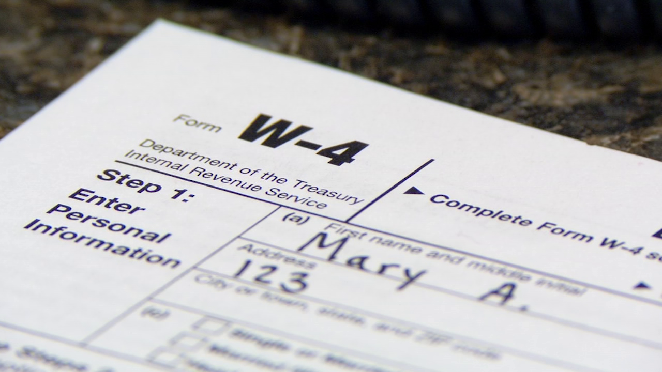
W-4 Form
10B:
Notes:
Form W-4 is an Internal Revenue Service tax form completed by an employee in the United States. The employer calculate how much federal income tax is to be withheld from your paycheck. There a new state w4 form that again you should consult with a tax professional to get direction on how to fill out this form. Beware there is a new W4 form available 2020 and Oregon has a new form. Please consult a tax professional to fill out the new forms.

Slide 89
Best Practice for Tax Curriculum should include
Definition of tax form ie. 1040, 1099MISC
Explanation of what is W2 vs W4
Where to complete your taxes for free in local communities
Consequences to not filing
Budget and Planning for Your Refund
Notes:
W2 is what the employer reports the total income withholding for the tax year. You use this information to prepare taxes.
W4 if the employees request to employer to indicate how much to withhold from paycheck.
1099MISC if general for contracted worker and other use

Slide 90
Gather your documents
Before you can do your taxes, gather all your documents to show your:
Identity: Photo ID and SS/ITIN card/letter for everyone on your return – spouse, parents, kids.
Income: wages, tips, unemployment benefits
Deductible expenses: medical, donations, work expenses
Expenses for Credits: Childcare and Education Expenses
Other: Last year’s return helps if you have it!
Notes:
Pass out check list of what to bring Helping Saver be prepared to file taxes is helpful.

Slide 91
Documents for Income
Taxable income 10c
W-2: wages and salaries, tips
1099-INT: interest from a bank account
1099-G: unemployment benefits
1099-MISC: prizes, jury duty,
W-2G: gambling winnings
Alimony
Any other income not reported on above forms
1099-R Retirement income
1099 SSA Social Security
Non-taxable income – unnecessary to track
Child support, worker’s compensation, food stamps, reimbursements
Keep track of tips throughout the year, then compare to tips reported on your W-2.
Keep track of gambling losses, too!
Notes:
Education on the difference between Tax and nontaxable income
What qualifies a nontaxable income:
More categories of non-taxable income. Child support payments; gifts, bequests and inheritances; welfare benefits; damage awards for physical injury or sickness; cash rebates from a dealer or manufacturer for an item you buy; and reimbursements for qualified adoption expenses.

Slide 92
Ways to grow your tax return
1098-E: student loan interest
1098-T: Education expenses
Taxes: state income or sales tax, property taxes
Medical: doctor & dentist visits, hospital bills, prescriptions, some medical insurance premiums, as well as a transportation costs
Donation: receipt listing value of cash/items donated, list of items donated (if belongings), name of charity
Notes:
Keeping proper documentation is important to growing your refund.

Slide 93
Ways to grow your return
Child & Dependent Care Credit & Working Families Credit
Receipts for care expenses, which allowed you to work, seek work, or attend school
Caregiver name, address, and identifying number (EIN or SSN)
Payments cannot be to sibling or parent of child and caregiver must be over 18 years old
Save your receipts! Oregon asks for proof of 1 in 3 returns claiming this credit. As long as you send them in, you’ll be all set!

Slide 94
Ways to grow your return
Retirement Savings Contributions:
Contribution to Traditional or Roth IRA can help to reduce taxable income and allows you to save for your future.
Oregon College Savings Plan
New this year- contribution made to OCSP could be eligible to receive a credit up to $300 for joint filer and $150 for single
Notes:
Oregon College Saving Plan: All Oregon taxpayers are eligible to receive a state income tax credit up to $300 for joint filers and up to $150 for single filers on contributions made to their Oregon College Savings Plan account.

Slide 95
EITC
Maximum Credit Amounts The maximum amount of credit for Tax Year 2019 is:
$6,557 with three or more qualifying children
$5,828 with two qualifying children
$3,526 with one qualifying child
$529 with no qualifying children
Notes:
Refer to handout at your table
The Earned Income Tax Credit (EIC or EITC) is a refundable credit for workers who earn low or moderate incomes. ... If you qualify for the Earned Income Tax Credit you can reduce your taxes and increase your tax refund. The EITC allows more working people and their families to keep more of their hard-earned money.
Oregon ranks last in EITC participation, It estimated that Oregonians leave 130 million dollars unclaimed.
Oregon College saving plan up to contribution to 529 plan up to $300

Slide 96
Paths to receiving your refund
E-File with Direct Deposit – File your tax return electronically (E-file) to speed up your refund. Tell the IRS to deposit the refund directly into your bank account—by providing your account number right on your tax return. You can get a refund in about 10 days this way—without paying one cent extra for a loan.
Get a bank account – If you don’t have a bank account, open one up to take advantage of direct deposit.- this is the fastest way to get your refund.
Wait just a bit longer – Do you really have to get cash from your tax refund today? Can you wait a few weeks to save more than $100? If you have an urgent bill to pay, ask for more time until the tax refund check comes from the IRS. Don’t take on a new debt to pay an old bill.
Notes:
And, the prepaid cards mentioned before.

Slide 97
Paths to receiving your refund
Avoid check cashers – Check cashers charge an extra fee to cash RAL and tax refund checks. Some check cashers charge up to 7% to cash a RAL check—the average is about 3%. So if you receive a $2,000 refund, it would cost you and average of $60 to cash the RAL check—on top of the RAL and tax preparation fees. A smarter move is to use a bank account.
Contact the Taxpayer Advocate Service – If you are suffering an economic hardship and need your refund quickly, the Taxpayer Advocate Service may be able to assist you. Call 1-877-777-4778.
Notes:
And, the prepaid cards mentioned before.

Slide 98
How the U.S. tax system disadvantages racial minorities
Tax systems empower only those who can take advantage of the tax benefits
In 2012, 3/4 of white families owned a home, compared to less than half of blacks and Hispanics. The median home value among white homeowners is $45,000 more than that among black homeowners.
Fewer people of color qualify to use tax benefits such as mortgage interest tax deduction, etc.
Washington Post 2016
https://www.washingtonpost.com/news/monkey-cage/wp/2016/04/18/how-the-u-s-tax-system-disadvantages-racial-minorities/
Notes:
As Americans rush to file their taxes by today’s deadline, many of them will take advantage of the tax breaks afforded them by the U.S. government. The government allows us to reduce our tax burden by taking deductions for things such as home mortgage interest and individual retirement accounts.
But these benefits won’t help all Americans. These benefits may have value — such as encouraging Americans to save and invest — but those benefits disproportionately help whites and provide less to people of color.
Racial disparities in tax treatment begin at home. For most homeowners, their home is far and away their biggest and most important financial asset. However, racial minorities are less likely to own a home, and, if they do, tend to own one of lower value.
In 2012, three-fourths of white families owned a home, compared to less than half of blacks and Hispanics. The median home value among white homeowners is $45,000 more than that among black homeowners

Slide 99
Tools for Saving Tax Refund
Use tools that work for you
Savings Accounts, Smartypig.com
Certificates of deposit (CDs)
US Savings Bonds
Piggy Banks!
Individual Development Accounts
Find IDA partner near you at https://oregonidainitiative.org/find-ida-provider/
Notes:
Ask the group if they have methods that they use to save money. Some examples include:
Savings Accounts
CDs. Certificates of deposit (CDs) is money you set aside for a set time—usually a preset period from six months to five years. The bank pays you interest until the maturity of your CD and at the end of the term you can cash in your CD or roll over to a new CD (you must tell the bank what you’ve decided before the CD matures). You can't add to or withdraw from CDs during the term- there is usually a penalty for withdrawing early and you forfeit earned interest. However, CDs usually have a higher interest than savings accounts or money markets, typically with the highest rates for the longest terms.
US Savings Bonds. US Savings Bonds are savings instruments issued by the U.S. government’s Department of Treasury. You can purchase them at most banks or online at Treasury Direct in increments of $50 and there is no fee (you spend $50 for a $50 bond). You can redeem your bonds anytime after 12 months and they grow in value for up to 30 years. Interest accrues every month, but will not be distributed until you redeem the bond. The interest is also compounded every 6 months. This means that every six months you will get interest on both the principal AND the interest for the previous 6 months. Savings bonds can be redeemed at your local bank, credit union, savings & loan or similar institution. You will be asked to present identification and sign the back of each bond you want to redeem, and the financial institution will certify your signature. You can also purchase bonds as gifts for other people- all you need is their name. You have to provide your Social Security Number to make the purchase, but you do not need the Social Security Number of the giftee.
Piggy Banks!
Individual Development Accounts. Individual Development Accounts (IDAs) are matched savings accounts that can be used only for purchasing a first home, capitalizing a small business, or for educational or job training expenses. There are IDA accounts offered around the city. Innovative Changes offers education IDAs where you receive a $3 for every $1 you save for your education. To look up an IDA program near you visit: vidaoregon.org
Smartypig.com an online savings account that helps you save for goals that you identify. With higher interest rate then your traditional bank savings account

Slide 100
Use Your Tax Refund Strategically
Make sure you’ve met all your needs for the month with your regular income
Look at past debt that you’ve been meaning to pay.
Now, you can start looking ahead to anticipate expenses over the next year.
Birthdays, holidays, car repairs, winter heat, water bills, seasonal unemployment….these are all things you can budget your tax return to cover.
Take some time to fill out the tax return budget worksheet.
Notes:
IDA savers can

Slide 101
Table Discussion
At your table answer this questions:
Where does this fit within the financial education that we already provide?
What challenges / barriers do you anticipate with providing Tax workshops in you financial Education curriculum?

Slide 102
Resources
Dial 211 or visit 211.org to find a tax site near you
IRS hotlines:
For individuals: (800) 829-1040
Business and Specialty Tax Line: (800) 829-4933
Refunds hotline: (800) 829-1954
Taxpayer Advocate Service: 1-877-777-4778.
Free AARP tax aide sites https://www.aarp.org/money/taxes/aarp_taxaide/
Legal Aid Services of Oregon 1-888-610-8764
CASH Oregon.org /locations (website is available in mid Jan VITA tax services).
Notes:
Legal Aid Services of Oregon
Legal Sid Services of Oregon is an independent non-profit law firm that provides statewide legal serviced to low income clients free of charge. The Statewide Tax Clinic is designed to help people who cannot afford a private attorney.
They can help people with:
Represent clients in Tax Court
Stop liens and levies
Assist with audits
Appeals Earned Income Credit denials
Settle tax debts
Help with innocent Spouse Relief and Injured Spouse claims.
You can access this resource by calling the number on the slide. CASH Oregon can do client screening for the lawyers on Thursdays Only after 4Pm. Call the number listed to intakes

Slide 103
Questions?
Rachell Hall
Casa of Oregon/ Innovative changes
rhall@casaoforegon.org
503-687-3336

Slide 104
Investments & Retirement
Ross Kanaga

Slide 105
This discussion is intended to broaden awareness around some investment topics. It is not intend to provide specific investment recommendations. Please do your own research and seek out a professional if you need further counsel.

Slide 106
Roth IRA Role Play

Slide 107
Tax
Roth IRA
Index Fund
Index Fund
Index Fund

Slide 108
Outline
Roth IRA Icebreaker (Kinesthetic Learning)
FE Standards 12: Investing
Investing Foundations & Action Steps
Designing an “Investing Module”
To Teach or Recruit?
Community Resources
Questions & Answers

Slide 110
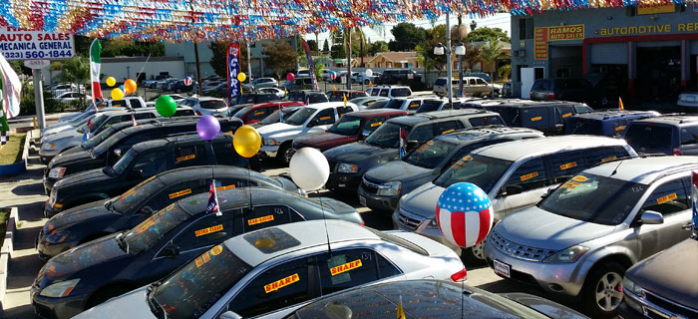

Slide 112
Can we teach investing?

Slide 113
https://www.300hours.com/articles/an-insiders-view-on-private-banking-hedge-funds-i-banking

Slide 114
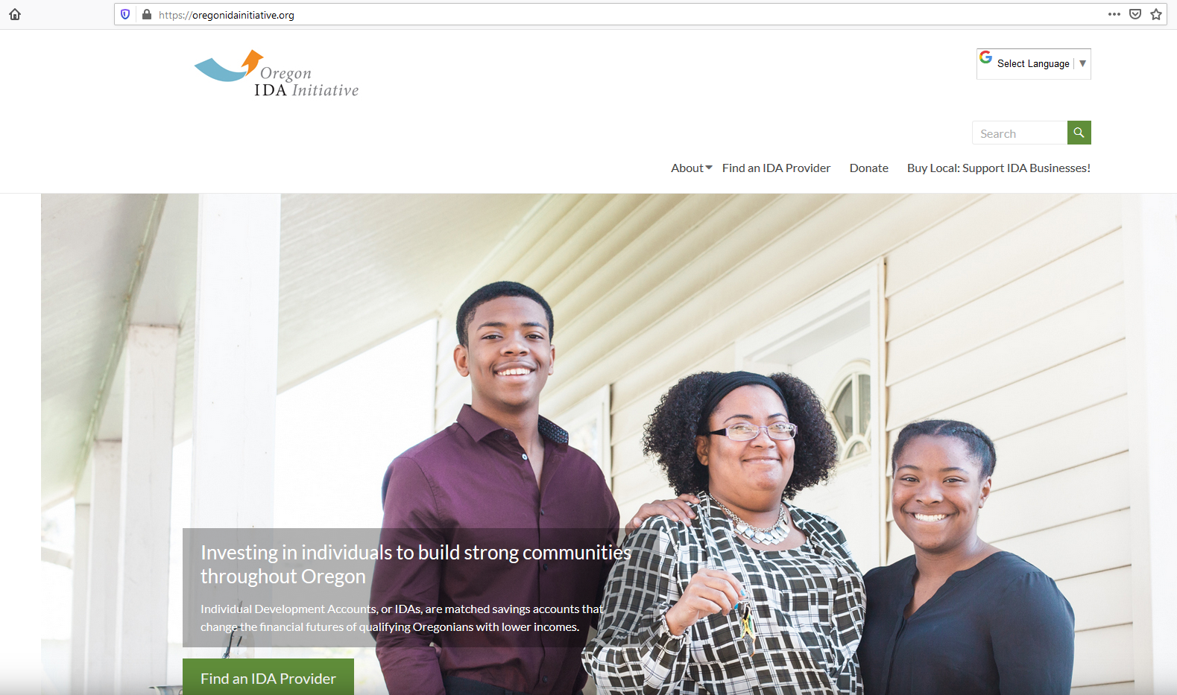

Slide 115
Saving vs. Investing
(FE Standard: 12A)
Emergency Savings
Savings for Asset Goals
Long-term Savings

Slide 116
Foundations of Investing
Open a Roth IRA
Purchase an Index Fund

Slide 117
Tax
Roth IRA
Index Fund
Index Fund
Index Fund

Slide 118
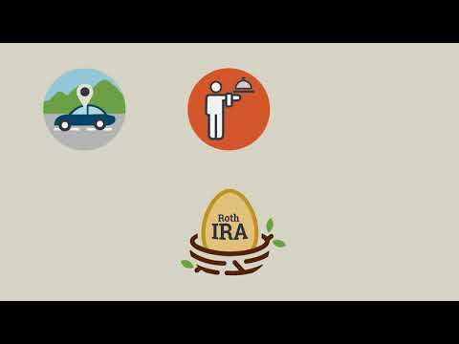
OregonSaves is a Roth IRA
https://youtu.be/3dEs0PWOy9g

Slide 119
Retirement Savings Contributions Credit (Saver’s Credit)
Form: 8880
https://www.irs.gov/retirement-plans/plan-participant-employee/retirement-savings-contributions-savers-credit

Slide 120
Where with low fees?
Brokerages | RoboAdvisors | CU/Banks
Schwab Vanguard Fidelity | Betterment Wealthfront | ?

Slide 121
Questions to ask as consumers.
What is a “fiduciary?”
https://www.sec.gov/investor/pubs/sec-questions-investors-should-ask.pdf

Slide 122
Foundations of Investing
Open a Roth IRA
Purchase an Index Fund

Slide 123
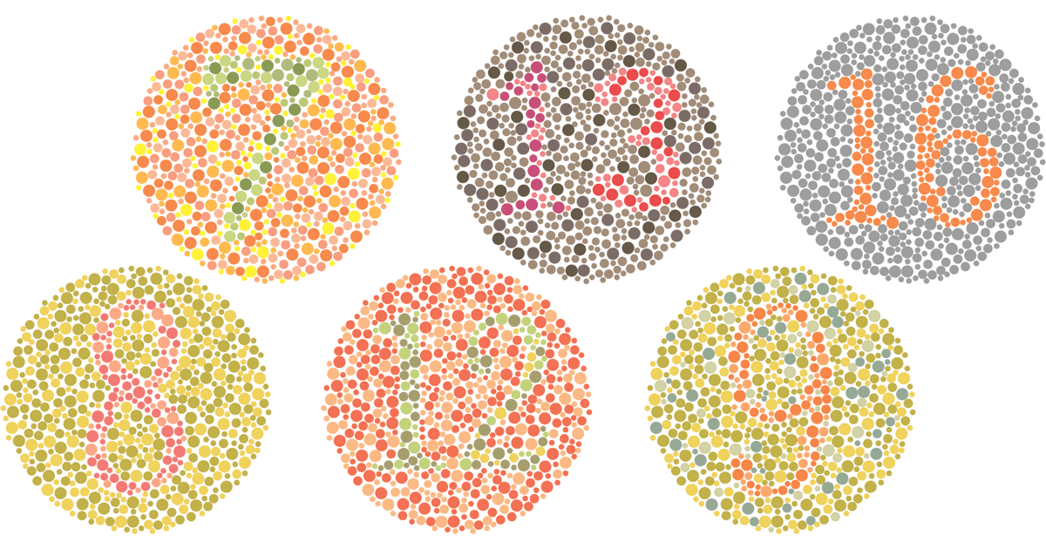

Slide 124
Purchase a low-fee Index Fund
Bond Index Fund
Stock Index Fund
Nike
WeWork
Municipal
US
Tresurary
Mortgage-backed Securities
Apple
Walmart
Corporate

Slide 125
Target Retirement Date Fund
Bond Index Fund
Stock Index Fund
Municipal
US
Tresurary
Mortgage-backed Securities
WeWork
Nike
Corporate
Apple
Walmart

Slide 126
Thinking about Risk
Notes:
Demas asks: What is a good risk?
Answer: There is not a “good” or “bad” risks--there are different risks for different stages of life.

Slide 127
Foundations of Investing
Open a Roth IRA
Purchase an Index Fund
??

Slide 128
Foundations of Investing
Open a Roth IRA
Purchase an Index Fund
Don’t touch. :) The Power of Time

Slide 129
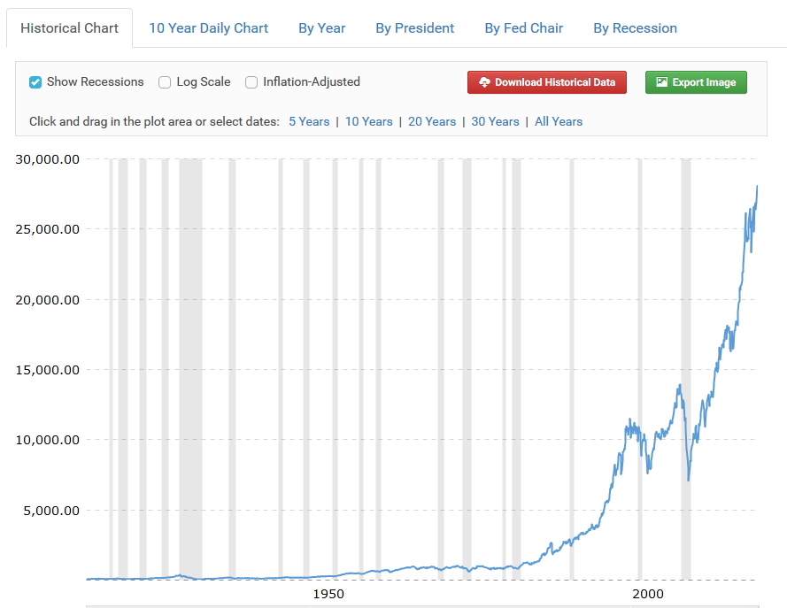
www.macrotrends.net

Slide 130
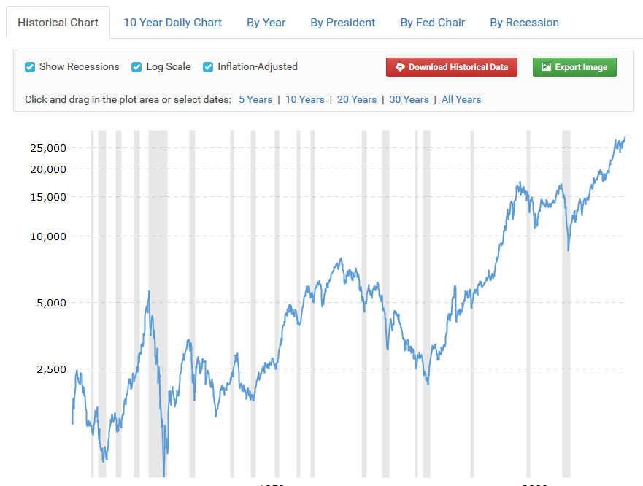
www.macrotrends.net

Slide 131
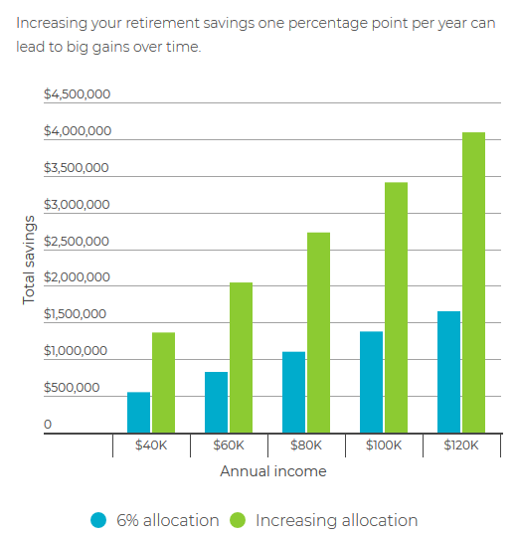
Small increases add up
https://infogram.com/copy-small-increases-add-up-1hke60zo785345r

Slide 132
Designing an Investing Module
Notes:
Demas asks: What is a good risk?
Answer: There is not a “good” or “bad” risks--there are different risks for different stages of life.

Slide 133
Teach or recruit volunteer?

Slide 134
Resources
To Start:
NerdWallet Investing 101
To Continue:
FINRA Investor Education Library
JL Collins: Stock Series

Slide 135
Keep it simple.
ross.kanaga@devNW.org

Slide 136
Investing Question & Answer
ross.kanaga@devNW.org

Slide 137
Reflecting on today

Slide 138
Today’s Topics
Behavioral Economics
Role of Economic Literacy in FE
Financial Education / Financial Coaching
Adult Learning
Overview of Financial Education Standards
Session A: Consumer Rights & Identity Theft
Session B: Taxes
Session C: Investments

Slide 139
Thank you!

