Slide 1
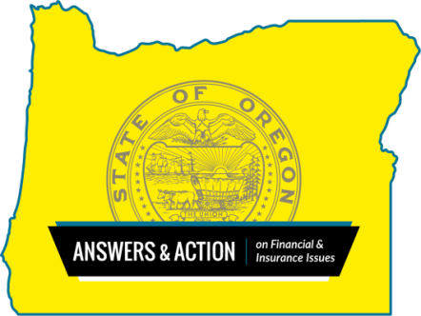
Census 2020
Be Prepared to Avoid Scammers
Nancy Yuill
Financial Education Outreach Coordinator
(503) 871-7099
Nancy.M.Yuill@Oregon.gov
Division of Financial Regulation (DFR)
www.dfr.oregon.gov

Slide 2
Division of Financial Regulation mission:
Protecting Oregonians’ access to fair products and services through education, regulation, and consumer assistance.
The comments made by the presenter do not necessarily reflect the position of the Department of Consumer and Business Services
The content of this presentation should not be construed as legal or professional advice

Slide 3
We Regulate:
State chartered banks, thrifts & credit unions
Mortgage lenders & home loan servicers
Consumer lenders (under $50k)
Insurance companies & agents
Check cashers & money transmitters
Debt collectors & debt management servicers
Pawnshops, payday and title lenders
Securities and financial advisors

Slide 4
Contact us:
www.dfr.oregon.gov
Consumer Hotline (toll-free)
888-877-4894 questions or complaints
1. Assist you in resolving complaints
2. Investigate violations of insurance & financial rules & regulations
3. Education and outreach

Slide 5
Census 2020
Be Counted and Avoid Scammers!
Everyone is counted
Every response is confidential

Slide 6
Avoiding Scams Online
The Census Bureau will not send unsolicited emails to request your participation in the 2020 Census.
During the 2020 Census, the Census Bureau will never ask for:
Your Social Security number or Individual Taxpayer Identification Number.
Your bank account or credit card numbers.
Your mother’s maiden name
Money or donations.
The Census Bureau will not contact you on behalf of a political party.

Slide 7
95% of households will receive your census invitation by postal mail
Invitations will start arriving around 3/12/2020.
You can respond to the census online, by email, or mail in a paper form. If you do not respond, there will be up to four reminders by mail, then an in-person follow up in late April.
About 5% of households will have the invitation dropped off at their home.
About 1% of households will be counted in person.

Slide 8
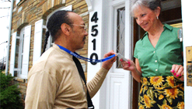
Staying Safe at Home
If someone visits your home to collect a response, check that they have a valid ID badge, with their photograph, a U.S. Department of Commerce watermark, and an expiration date.

Slide 9
Staying Safe at Home
If you still have questions about their identity, call 800-923-8282 to check or call the Census Bureau Regional Office to verify that the individual is a Census Bureau employee or to speak with their supervisor.
Oregon’s regional office is in Los Angeles.
Los Angeles 1-800-992-3530 or (818) 267-1700 Los.Angeles.Regional.Office@census.gov

Slide 10
How to identify a phone call from the Census Bureau
Most Census Bureau calls asking you to participate in a survey originate from one of the following numbers:
(812) 218-3144, Jeffersonville Contact Center
(520) 798-4152, Tucson Contact Center

Slide 11
If you receive a call and wish to independently verify that a number is from the Census Bureau, you can call one of the following numbers: 1-800-523-3205 Jeffersonville, IN 1-800-642-0469 Tucson, AZ 1-800-923-8282 Customer Service Center
VERIFY!

Slide 12
BE PART OF THE SOLUTION
Reporting Suspected Fraud
If you suspect fraud, call 800-923-8282 to speak with a local Census Bureau Rep. If it determined that the visitor who came to your door does not work for the Census Bureau, contact your local police.
Fighting 2020 Census Rumors
If you see or hear false information about the 2020 Census or the U.S. Census Bureau, please contact rumors@census.gov.
Resources www.2020census.gov www.dfr.oregon.gov www.identitytheft.gov www.oregon2020census.gov
www.annualcreditreport.com

